Slide 1


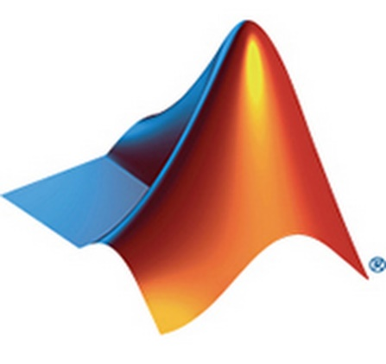
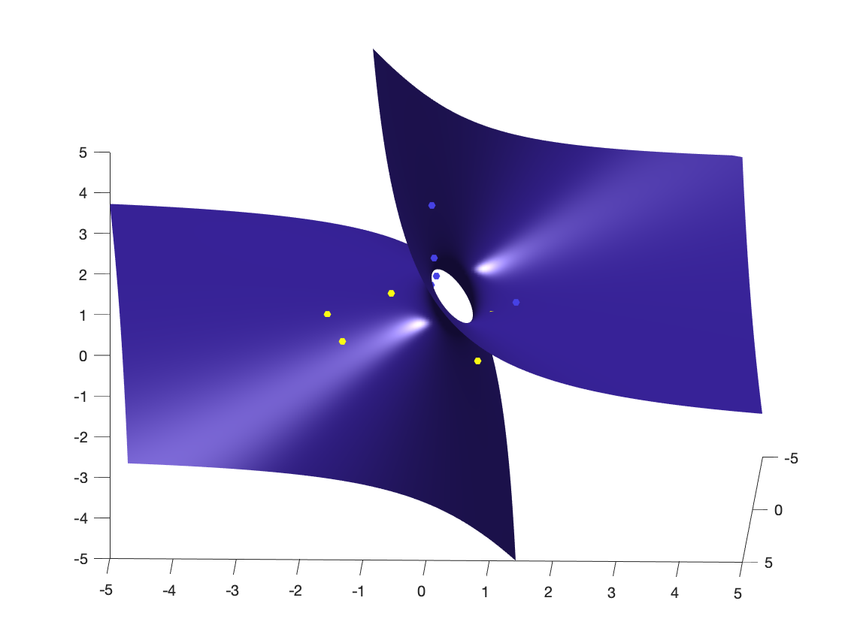
- CHETHAN M – PES2201800331 - S SREE KAUSTUB – PES2201800061 - KISHORE B R – PES2201800342 - G SAI CHARAN REDDY – PES22018000483
DIGITAL IMAGE PROCESSING USING MATLAB - PROJECT

Slide 2

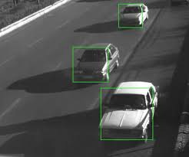
PROBLEM..!
DEVELOP A MATLAB CODE THAT CAN DETECT VEHICLES IN EACH FRAME OF A VIDEO AND GIVES THE VEHICLE COUNT OF THAT FRAME……
Notes:
When conducting research, it is easy to go to one source: Wikipedia. However, you need to include a variety of sources in your research. Consider the following sources:
Who can I interview to get more information on the topic?
Is the topic current and will it be relevant to my audience?
What articles, blogs, and magazines may have something related to my topic?
Is there a YouTube video on the topic? If so, what is it about?
What images can I find related to the topic?

Slide 3
The solution has 3 stages :
Develop the idea for a single frame
2
Extend the idea for collection of frames
3
Now introduce the car count feature
1
(i.e.) IMAGE PROCESSING
(i.e.) VIDEO PROCESSING
(i.e.) ADDED FEATURE
TRAIN
TEST
Notes:
When conducting research, it is easy to go to one source: Wikipedia. However, you need to include a variety of sources in your research. Consider the following sources:
Who can I interview to get more information on the topic?
Is the topic current and will it be relevant to my audience?
What articles, blogs, and magazines may have something related to my topic?
Is there a YouTube video on the topic? If so, what is it about?
What images can I find related to the topic?

Slide 4
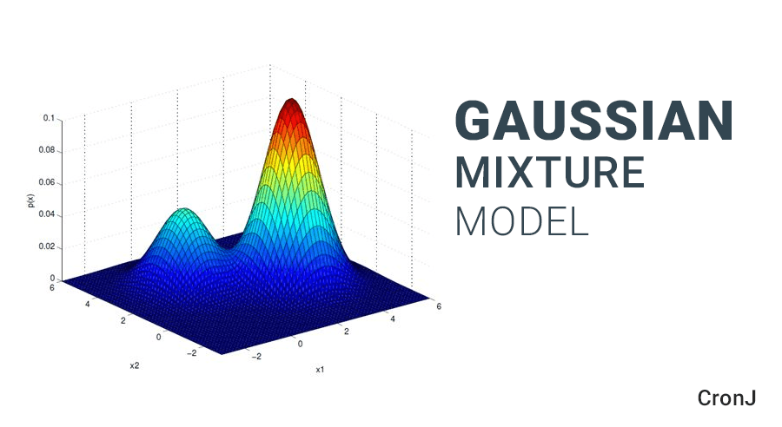
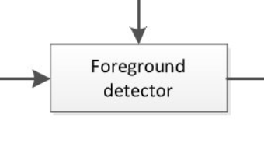
THE IDEA……
Notes:
You can use this slide as your opening or closing slide. Should you choose to use it as a closing, make sure you review the main points of your presentation. One creative way to do that is by adding animations to the various graphics on a slide. This slide has 4 different graphics, and, when you view the slideshow, you will see that you can click to reveal the next graphic. Similarly, as you review the main topics in your presentation, you may want each point to show up when you are addressing that topic.
Add animation to images and graphics:
Select your image or graphic.
Click on the Animations tab.
Choose from the options. The animation for this slide is “Split”. The drop-down menu in the Animation section gives even more animations you can use.
If you have multiple graphics or images, you will see a number appear next to it that notes the order of the animations.
Note: You will want to choose the animations carefully. You do not want to make your audience dizzy from your presentation.

Slide 5
PROJECT ASSUMPTIONS……
STATIONARY CAMERA
STATIC BACKGROUND
Notes:
You can use this slide as your opening or closing slide. Should you choose to use it as a closing, make sure you review the main points of your presentation. One creative way to do that is by adding animations to the various graphics on a slide. This slide has 4 different graphics, and, when you view the slideshow, you will see that you can click to reveal the next graphic. Similarly, as you review the main topics in your presentation, you may want each point to show up when you are addressing that topic.
Add animation to images and graphics:
Select your image or graphic.
Click on the Animations tab.
Choose from the options. The animation for this slide is “Split”. The drop-down menu in the Animation section gives even more animations you can use.
If you have multiple graphics or images, you will see a number appear next to it that notes the order of the animations.
Note: You will want to choose the animations carefully. You do not want to make your audience dizzy from your presentation.

Slide 6




Project status:
Stage 1 – completed
Stage 2 – completed
Stage 3 – incomplete
Image processing - TRAIN
Video processing - TEST

Slide 7
Project Phase-2
Use the developed idea on a test video and conclude the results.
Notes:
When conducting research, it is easy to go to one source: Wikipedia. However, you need to include a variety of sources in your research. Consider the following sources:
Who can I interview to get more information on the topic?
Is the topic current and will it be relevant to my audience?
What articles, blogs, and magazines may have something related to my topic?
Is there a YouTube video on the topic? If so, what is it about?
What images can I find related to the topic?

Slide 8
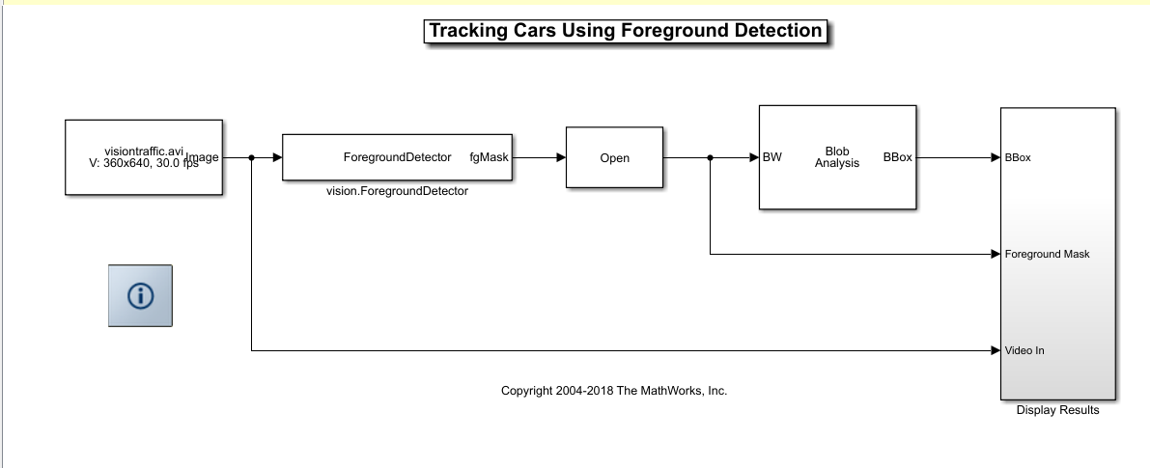
The Model
Notes:
When conducting research, it is easy to go to one source: Wikipedia. However, you need to include a variety of sources in your research. Consider the following sources:
Who can I interview to get more information on the topic?
Is the topic current and will it be relevant to my audience?
What articles, blogs, and magazines may have something related to my topic?
Is there a YouTube video on the topic? If so, what is it about?
What images can I find related to the topic?

Slide 9
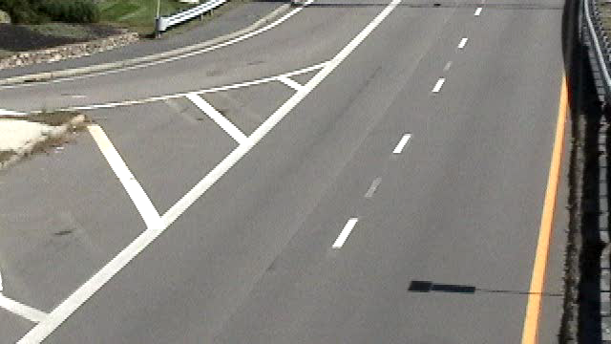
Input Dataset
Notes:
When conducting research, it is easy to go to one source: Wikipedia. However, you need to include a variety of sources in your research. Consider the following sources:
Who can I interview to get more information on the topic?
Is the topic current and will it be relevant to my audience?
What articles, blogs, and magazines may have something related to my topic?
Is there a YouTube video on the topic? If so, what is it about?
What images can I find related to the topic?

Slide 10
Code (train-image processing )
foregroundDetector = vision.ForegroundDetector('NumGaussians', 3, ...
'NumTrainingFrames', 50);
videoReader = VideoReader('visiontraffic.avi');
wo=VideoWriter('copy.avi');
open(wo);
for i = 1:300
frame = readFrame(videoReader); % read the next video frame
foreground = step(foregroundDetector, frame);
end
figure; imshow(frame); title('Video Frame');
figure; imshow(foreground); title('Foreground');
se = strel('square', 3);
filteredForeground = imopen(foreground, se);
figure; imshow(filteredForeground); title('Clean Foreground');
Notes:
When conducting research, it is easy to go to one source: Wikipedia. However, you need to include a variety of sources in your research. Consider the following sources:
Who can I interview to get more information on the topic?
Is the topic current and will it be relevant to my audience?
What articles, blogs, and magazines may have something related to my topic?
Is there a YouTube video on the topic? If so, what is it about?
What images can I find related to the topic?

Slide 11
Code (train-image processing)
blobAnalysis = vision.BlobAnalysis('BoundingBoxOutputPort', true, ...
'AreaOutputPort', false, 'CentroidOutputPort', false, ...
'MinimumBlobArea', 150);
bbox = step(blobAnalysis, filteredForeground);
result = insertShape(frame, 'Rectangle', bbox, 'Color', 'green');
numCars = size(bbox, 1);
result = insertText(result, [10 10], numCars, 'BoxOpacity', 1, ...
'FontSize', 14);
figure; imshow(result); title('Detected Cars');
videoPlayer = vision.VideoPlayer('Name', 'Detected Cars');
videoPlayer.Position(3:4) = [650,400]; % window size: [width, height]
se = strel('square', 3); % morphological filter for noise removal
Notes:
When conducting research, it is easy to go to one source: Wikipedia. However, you need to include a variety of sources in your research. Consider the following sources:
Who can I interview to get more information on the topic?
Is the topic current and will it be relevant to my audience?
What articles, blogs, and magazines may have something related to my topic?
Is there a YouTube video on the topic? If so, what is it about?
What images can I find related to the topic?

Slide 12
Code (test-video processing)
while hasFrame(videoReader)
frame = readFrame(videoReader); % read the next video frame
% Detect the foreground in the current video frame
foreground = step(foregroundDetector, frame);
% Use morphological opening to remove noise in the foreground
filteredForeground = imopen(foreground, se);
% Detect the connected components with the specified minimum area, and
% compute their bounding boxes
bbox = step(blobAnalysis, filteredForeground);
Notes:
When conducting research, it is easy to go to one source: Wikipedia. However, you need to include a variety of sources in your research. Consider the following sources:
Who can I interview to get more information on the topic?
Is the topic current and will it be relevant to my audience?
What articles, blogs, and magazines may have something related to my topic?
Is there a YouTube video on the topic? If so, what is it about?
What images can I find related to the topic?

Slide 13
Code (test-video processing)
% Draw bounding boxes around the detected cars
result = insertShape(frame, 'Rectangle', bbox, 'Color', 'green');
% Display the number of cars found in the video frame
numCars = size(bbox, 1);
result = insertText(result, [10 10], numCars, 'BoxOpacity', 1, ...
'FontSize', 14);
step(videoPlayer, result);% display the results
end
Notes:
When conducting research, it is easy to go to one source: Wikipedia. However, you need to include a variety of sources in your research. Consider the following sources:
Who can I interview to get more information on the topic?
Is the topic current and will it be relevant to my audience?
What articles, blogs, and magazines may have something related to my topic?
Is there a YouTube video on the topic? If so, what is it about?
What images can I find related to the topic?

Slide 14
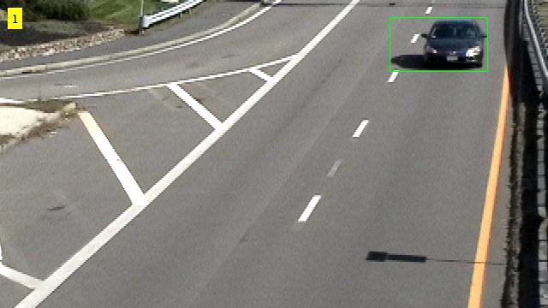
Final Output of the model
Notes:
When conducting research, it is easy to go to one source: Wikipedia. However, you need to include a variety of sources in your research. Consider the following sources:
Who can I interview to get more information on the topic?
Is the topic current and will it be relevant to my audience?
What articles, blogs, and magazines may have something related to my topic?
Is there a YouTube video on the topic? If so, what is it about?
What images can I find related to the topic?

Slide 15
Model review
Input dataset | Status | Accuracy
TRAIN - IMAGE | WORKING | 100%
TEST - VIDEO | WORKING | 100%
Notes:
When conducting research, it is easy to go to one source: Wikipedia. However, you need to include a variety of sources in your research. Consider the following sources:
Who can I interview to get more information on the topic?
Is the topic current and will it be relevant to my audience?
What articles, blogs, and magazines may have something related to my topic?
Is there a YouTube video on the topic? If so, what is it about?
What images can I find related to the topic?

Slide 16
THANK YOU

